Slide 1
Comparative Analysis: eToro vs Revolut vs Robinhood

Slide 2
Executive Summary
This report evaluates three leading trading platforms to identify the most suitable option for diversified investment across four key asset classes:
• Bitcoin (BTC)
• Commodities
• S&P 500 Index
• Bonds

Slide 3
Investment Scope
Bitcoin: High-growth digital asset with increasing institutional adoption
Commodities: Inflation hedge and portfolio diversifier (e.g., Gold)
S&P 500: Core equity market exposure to U.S. economy
Bonds: Capital preservation and yield generation via fixed-income exposure

Slide 4
Platform Feature Comparison Matrix

Slide 5
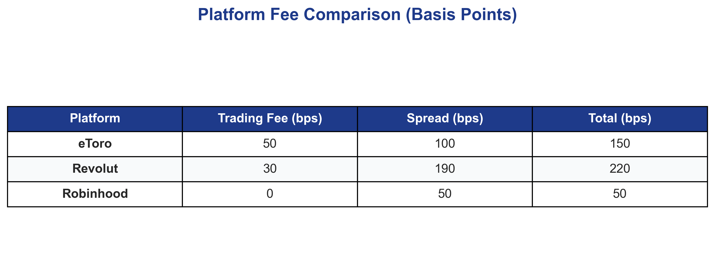
Platform Fee Comparison

Slide 6
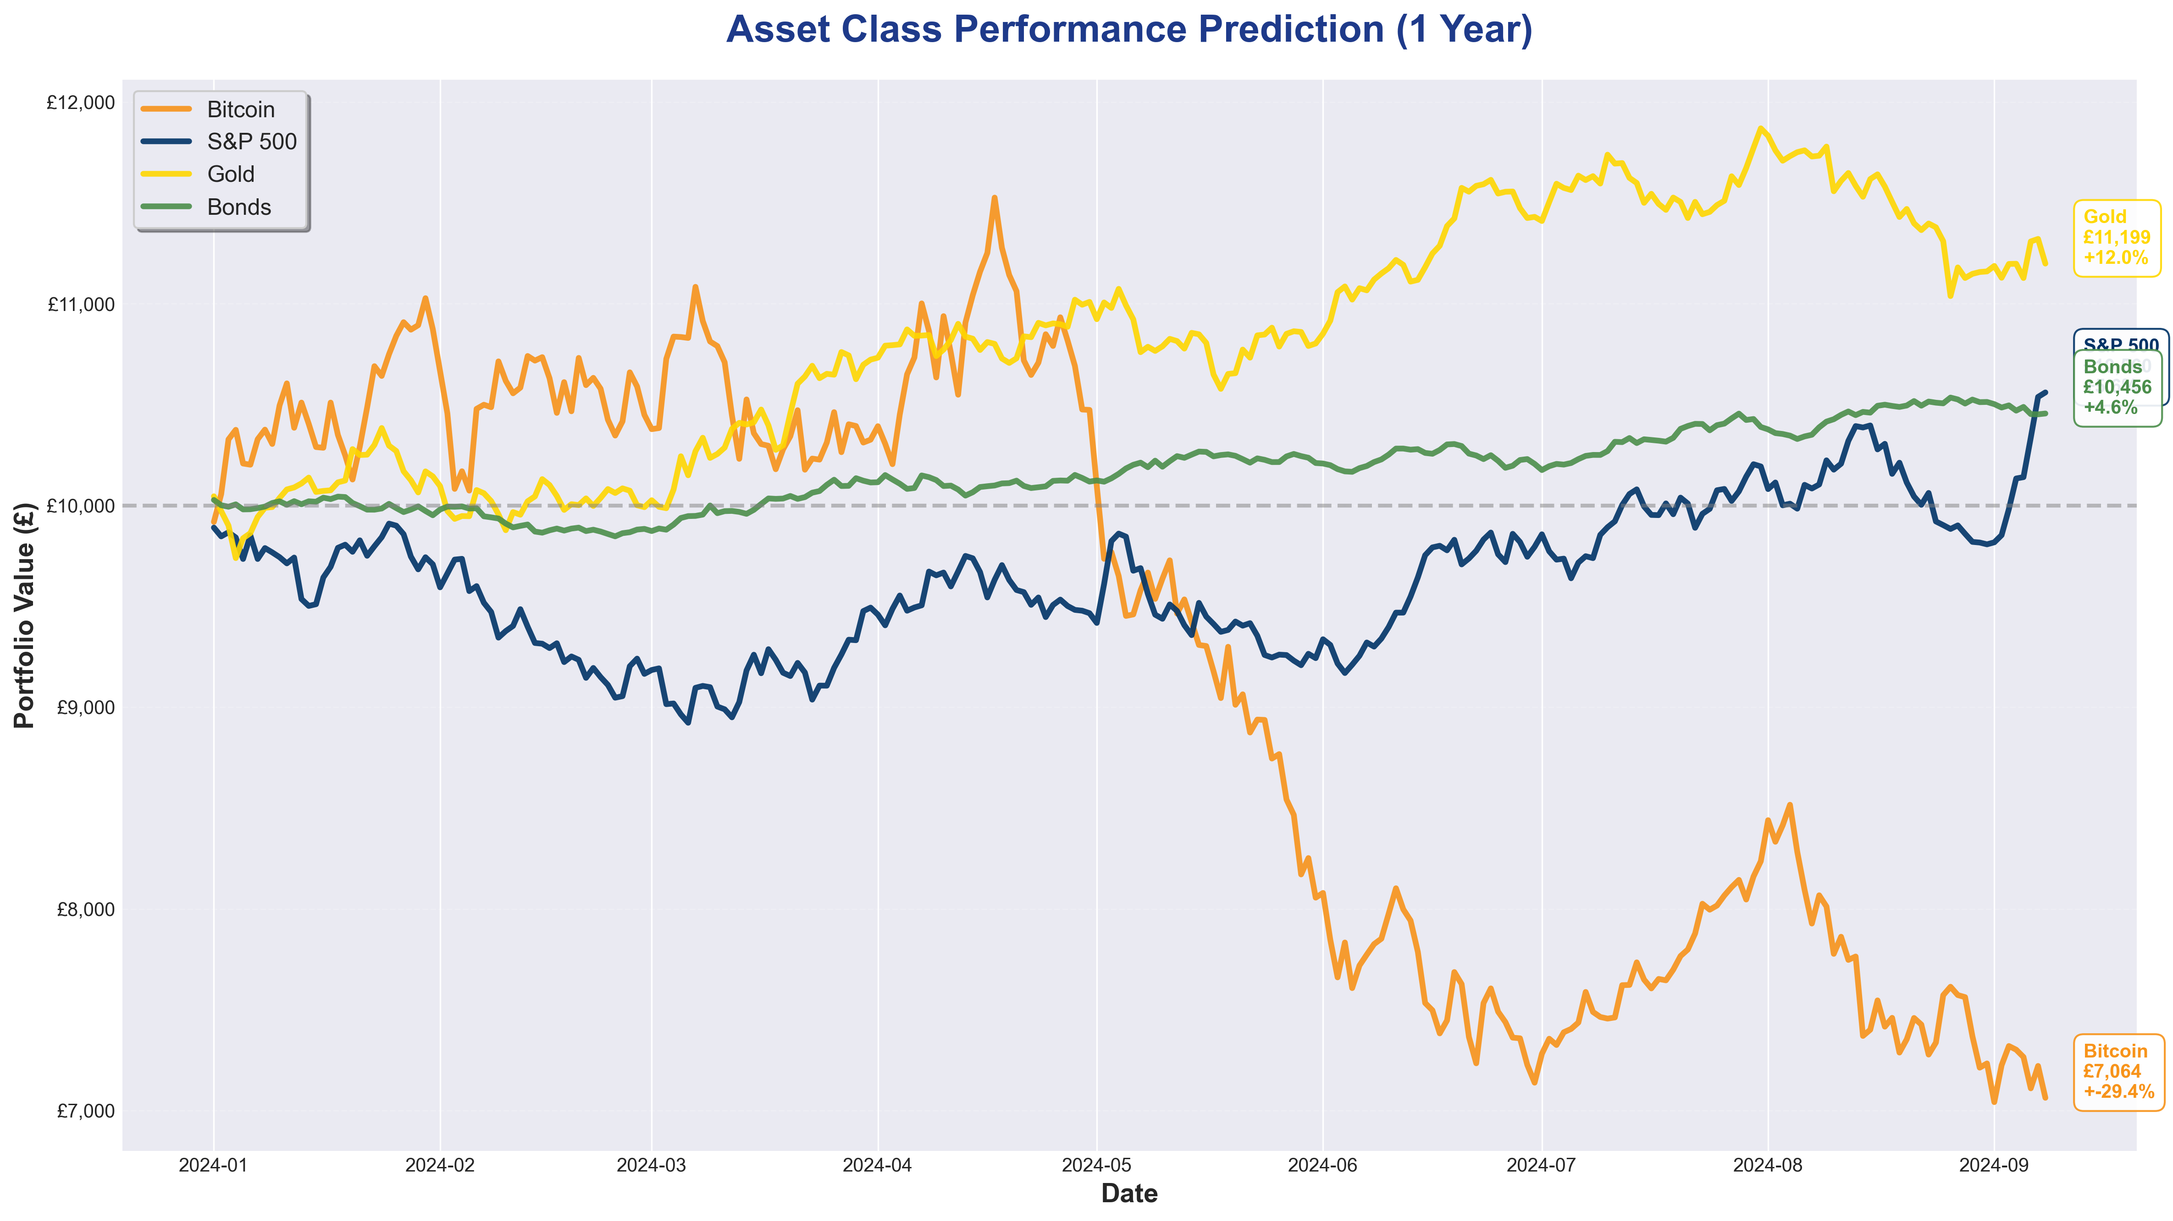
Asset Class Performance Predictions (1 Year)

Slide 7
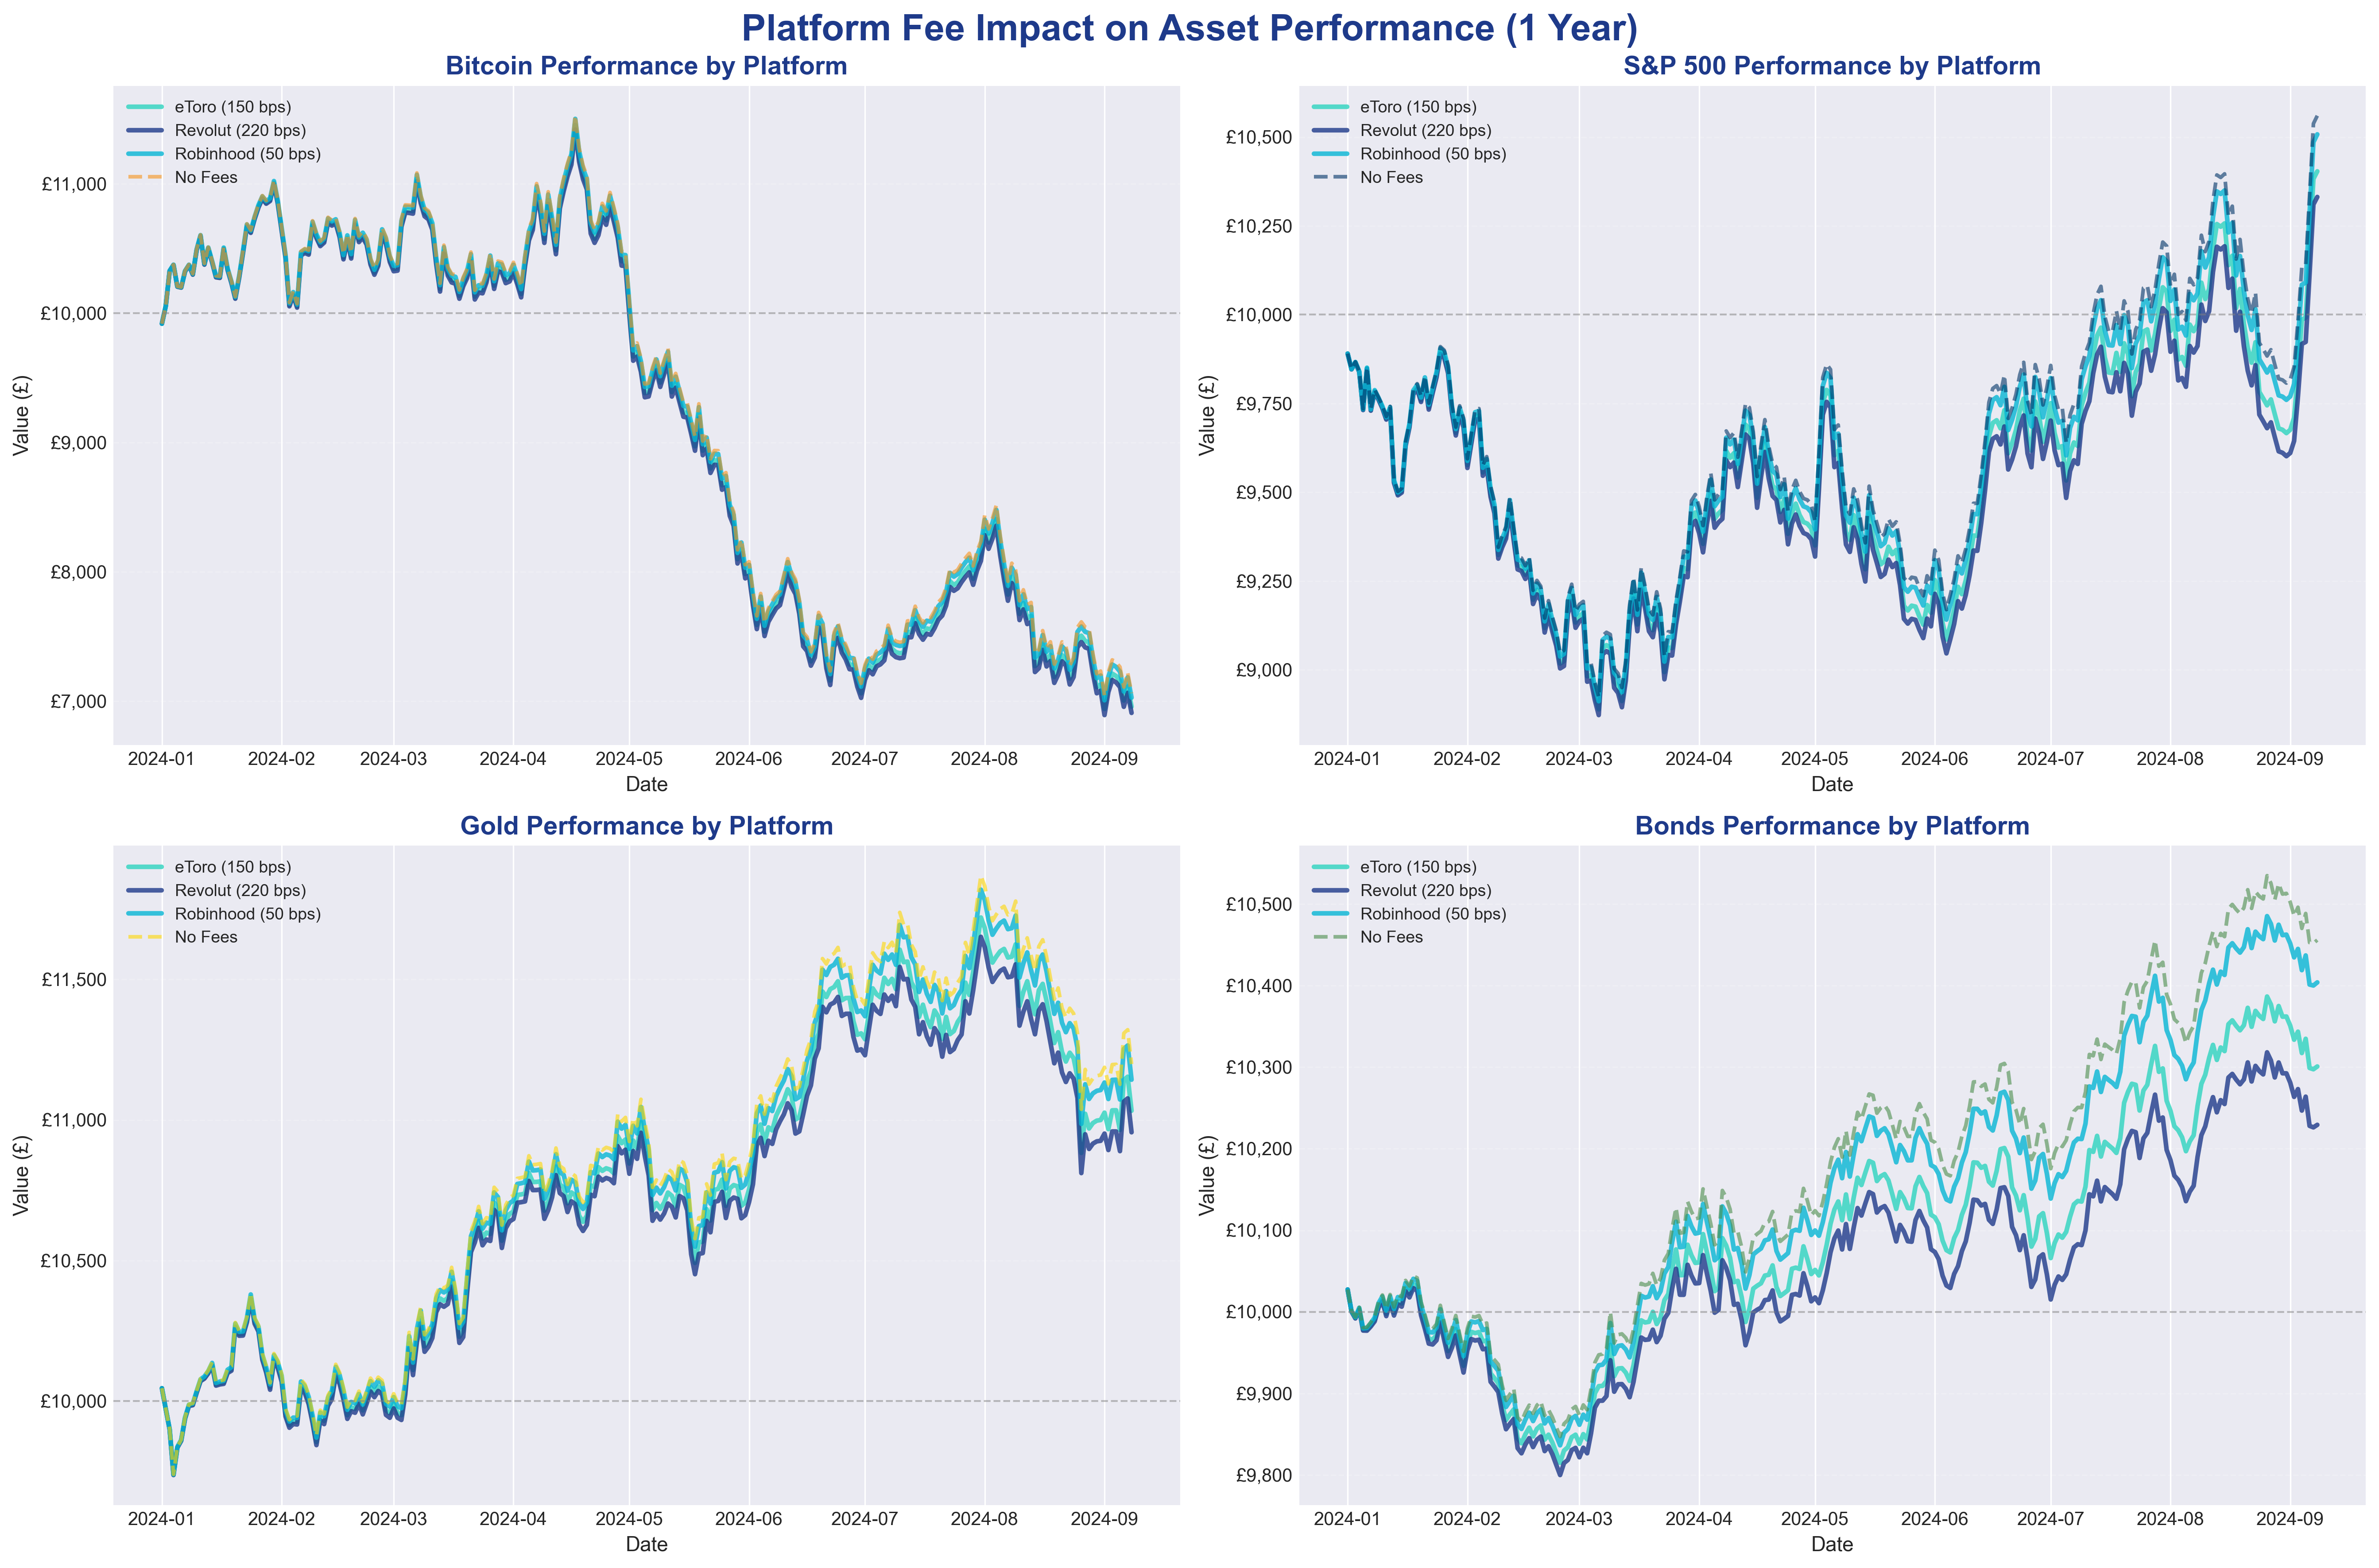
Platform Fee Impact Analysis

Slide 8
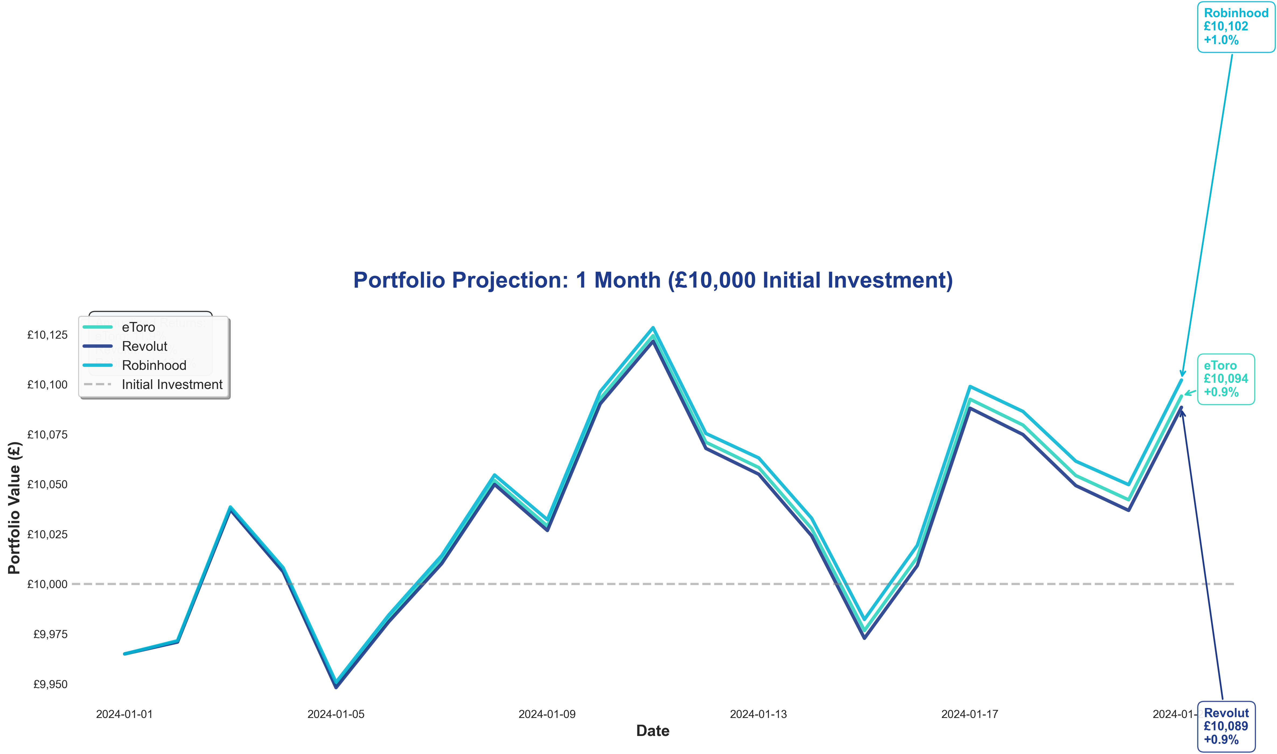
Portfolio Projection - 1 Month (£10,000 Investment)

Slide 9
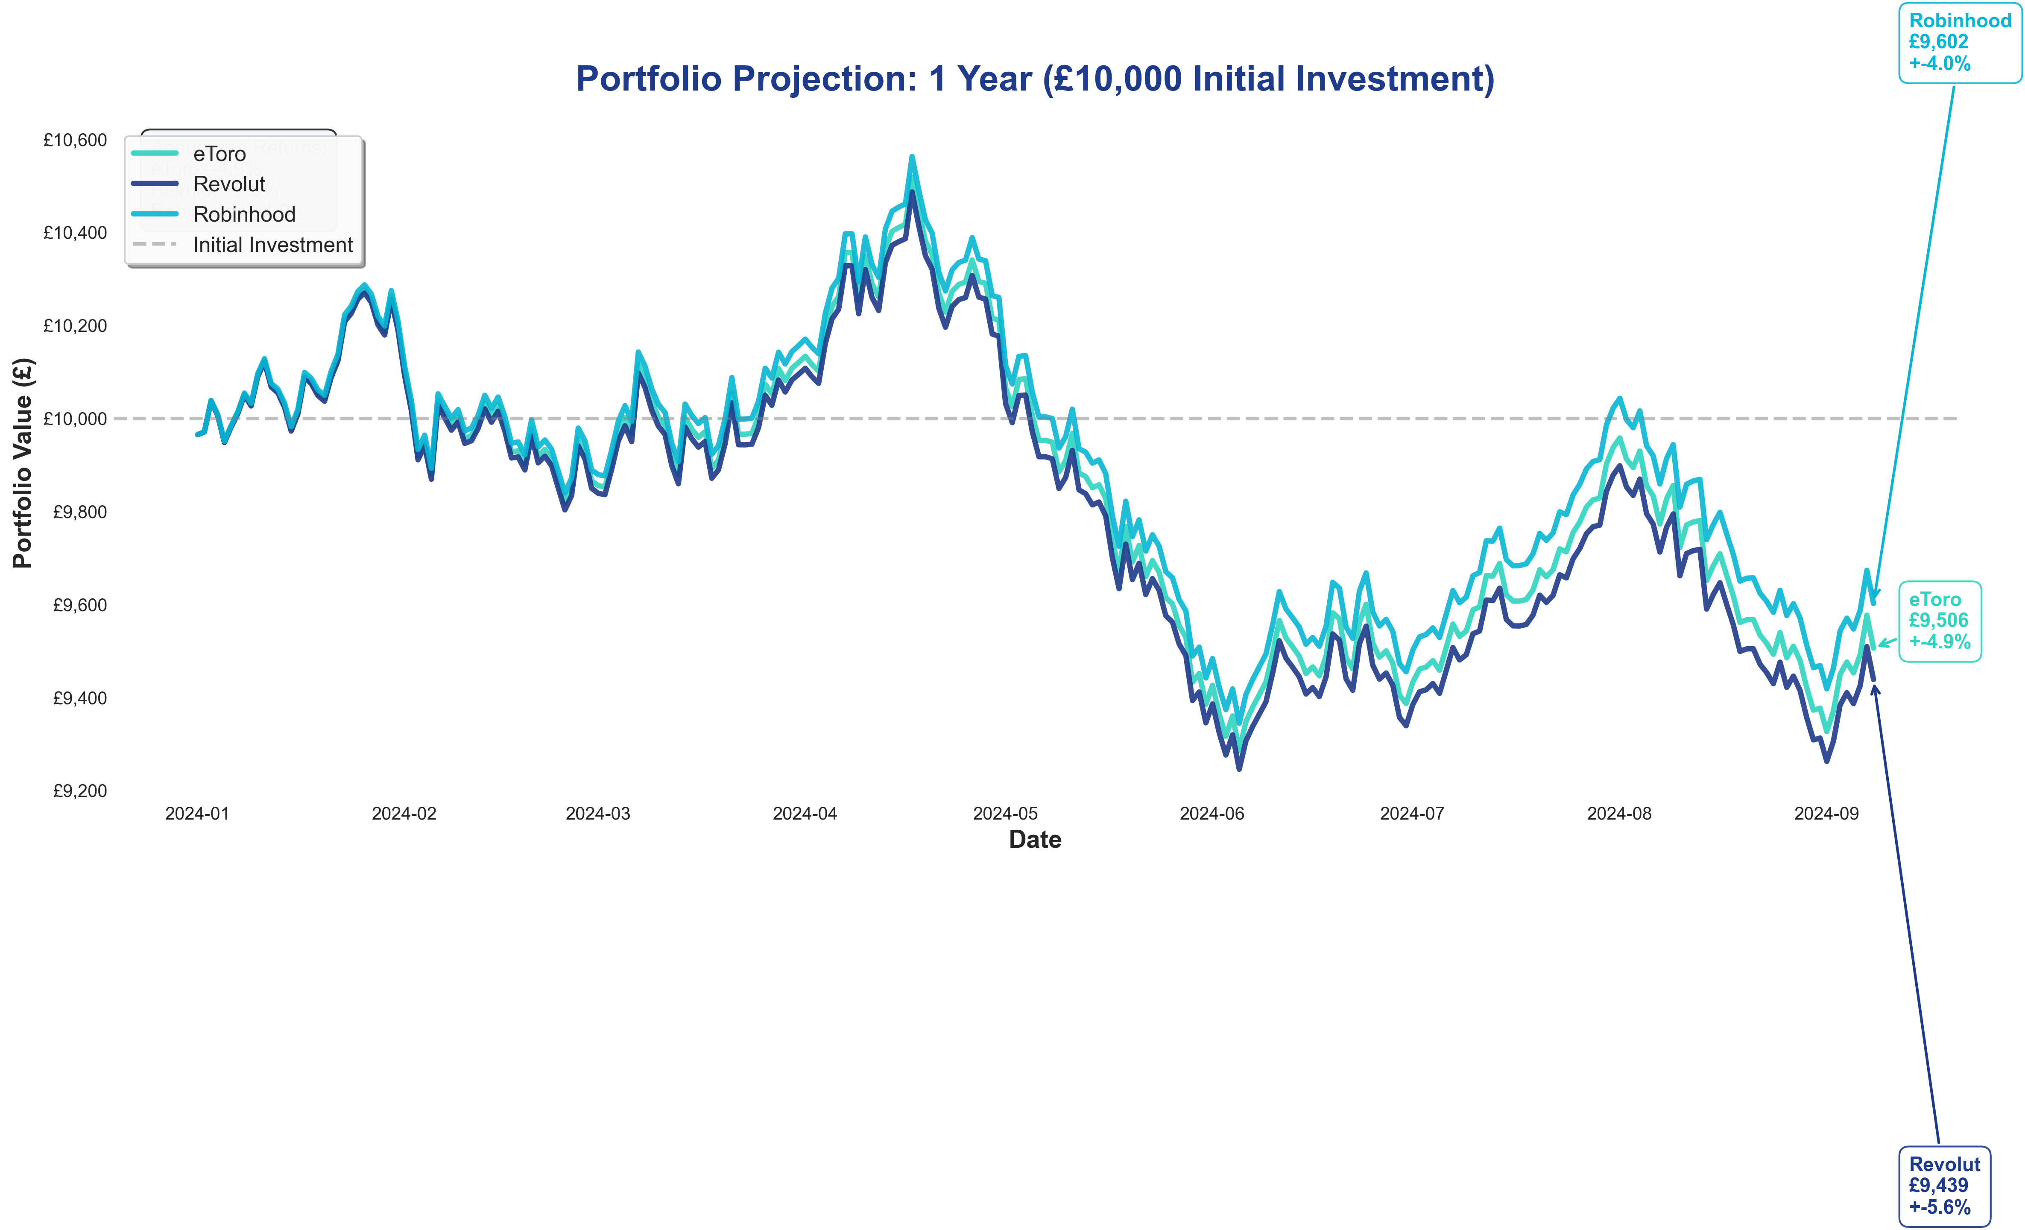
Portfolio Projection - 1 Year (£10,000 Investment)

Slide 10
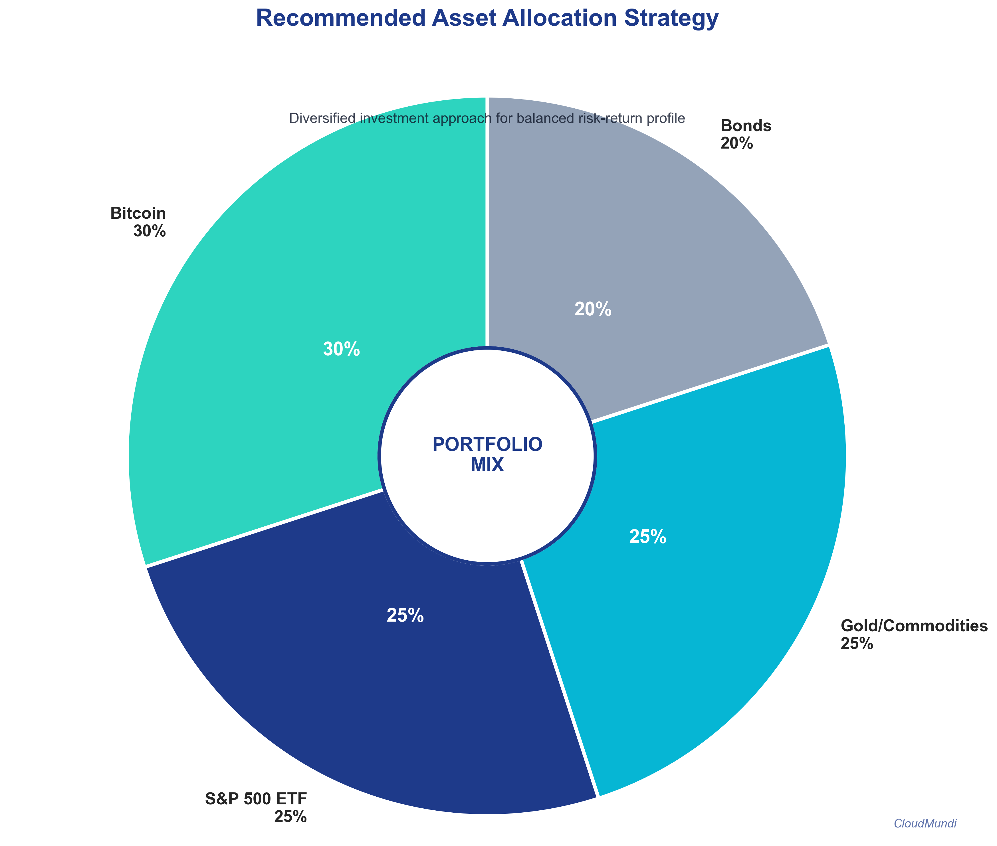
Recommended Asset Allocation

Slide 11
Platform Strengths & Limitations
eToro
✓ Multi-asset support, social trading, global coverage
✗ Higher trading spreads, limited U.S. access
Revolut
✓ Mobile-first, integrated banking, beginner-friendly
✗ High crypto spreads, limited products
Robinhood
✓ Commission-free, strong education, fractional shares
✗ U.S. only, no commodities, limited crypto wallet

Slide 12
🏆 Professional Recommendation
Recommended Platform: eToro
Rationale:
• Broadest functionality across all four investment categories
• Robust support for Bitcoin custody
• Access to commodities and diversified ETF offerings
• Global regulatory framework
Note: For U.S.-based users, Robinhood remains a strong alternative

